Slide 1
Acoustics at NHM
Ed Baker
Acoustic Biology Researcher Natural History Museum, London

Slide 2
21st Century museums 21st Century methods

Slide 3
21st Century museums 21st Century methods
Still think in decades and centuries as well as projects

Slide 4
Some History…

Slide 5
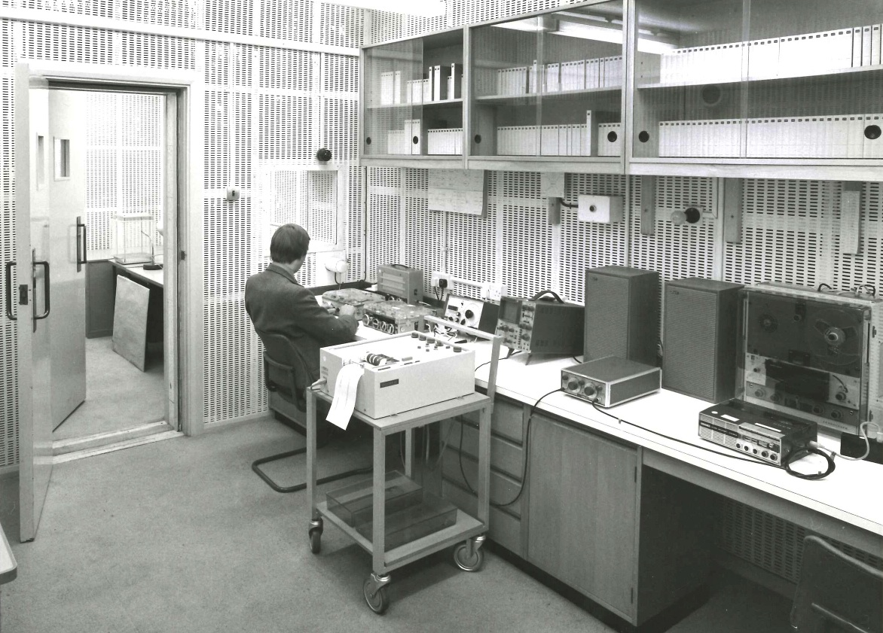
British Museum (Natural History) recording studio
1973-1998
bio.acousti.ca

Slide 6
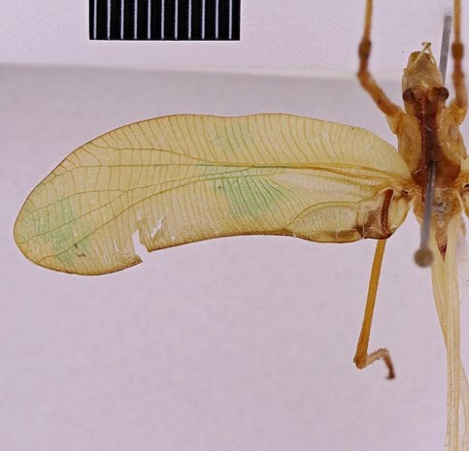
Horatosphaga raggei (Heller & Baker, 2017)
Discovered as new species from a sound recording
Heller, K-G., & Baker, E. (2017). From an old sound recording to a new species in the genus Horatosphaga (Orthoptera: Tettigonioidea: Phaneropterinae: Acrometopini). Zootaxa, 4323(3), 430-434.

Slide 7
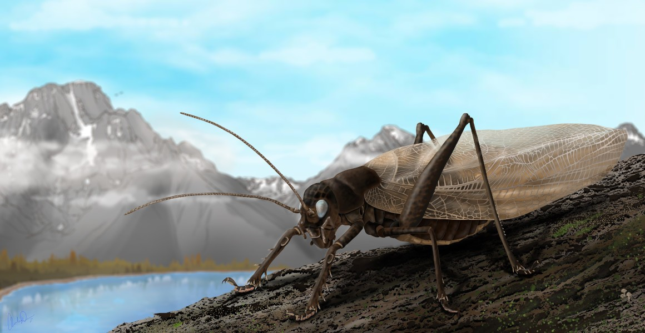
Prophalangopsis obscura
Sound reconstructed of species only known from male holotype
Woodrow, C., Baker, E., Jonsson, T., & Montealegre-Z, F. (2022). Reviving the sound of a 150-year-old insect: The bioacoustics of Prophalangopsis obscura (Ensifera: Hagloidea). Plos one, 17(8), e0270498.

Slide 8
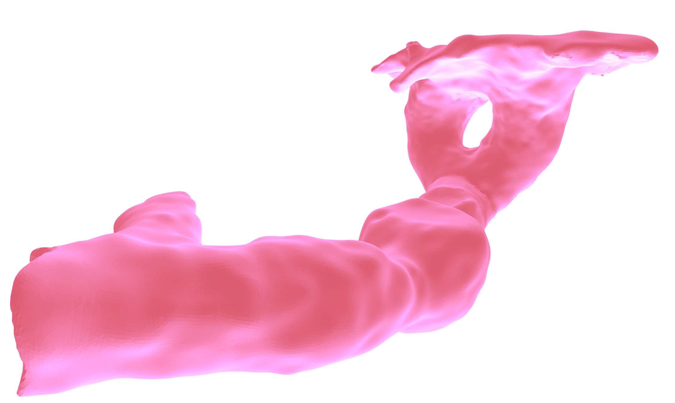
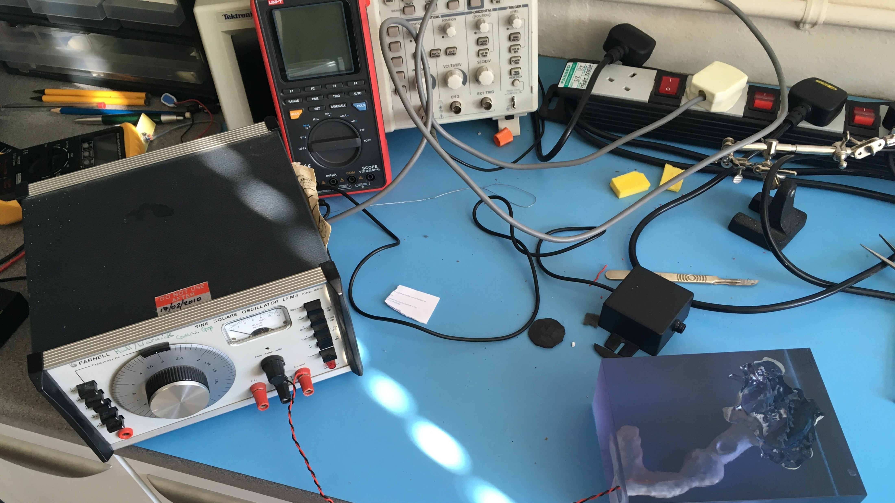
Acoustic burrow scan of mole cricket
Baker, E., & Broom, Y. S. (2015). Natural History Museum sound archive I: Orthoptera: Gryllotalpidae Leach, 1815, including 3D scans of burrow casts of Gryllotalpa gryllotalpa (Linnaeus, 1758) and Gryllotalpa vineae Bennet-Clark, 1970. Biodiversity Data Journal, (3).

Slide 9
The story so far: 🦗.fm

Slide 10
Sudden need to scale

Slide 11
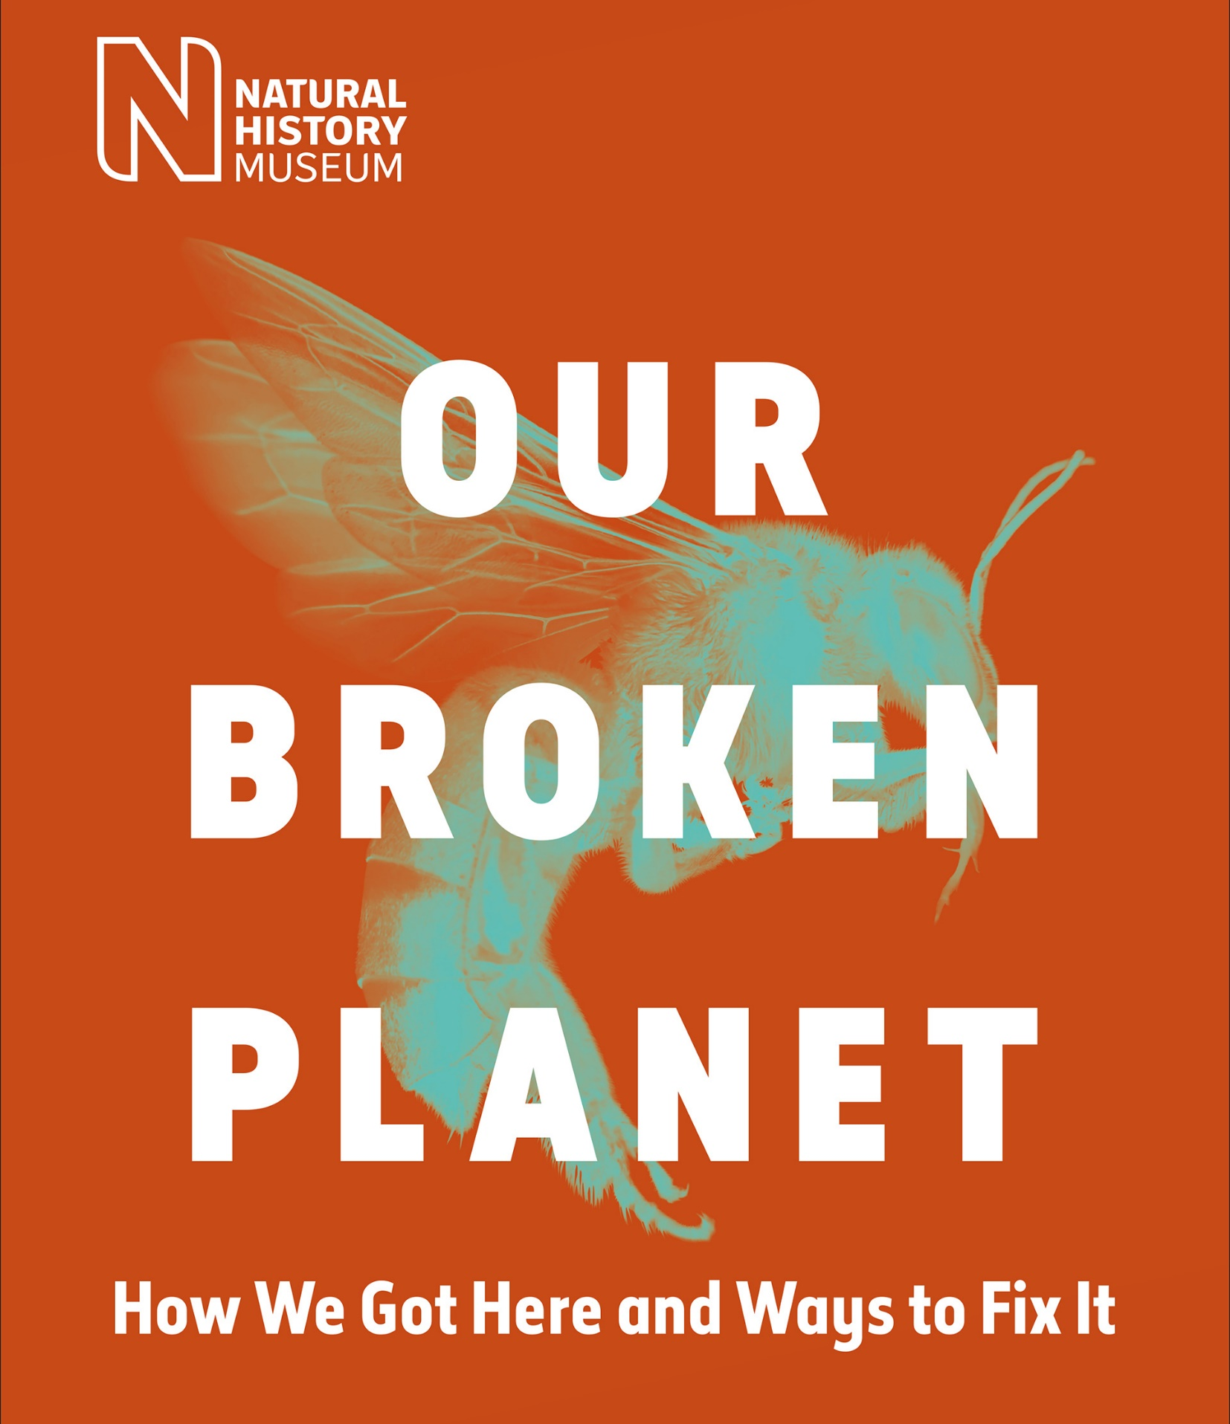
UK Nature Recovery
Research Theme
… develop and share scientific understanding of the composition and dynamics of the natural world, generating data, knowledge and tools that accelerate nature recovery in the UK and UK Overseas Territories
nhm.ac.uk/our-broken-planet

Slide 12
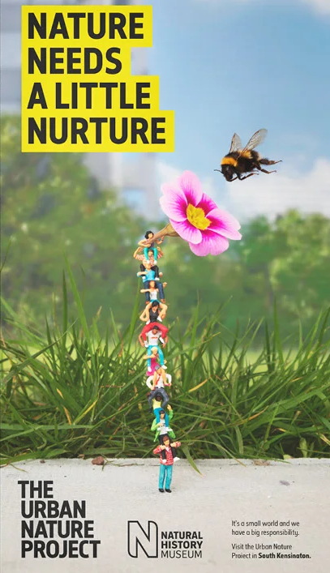
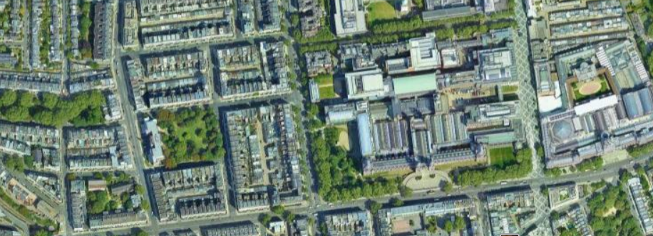
Urban Nature Project
The Urban Nature Project is developing new scientific tools and skills urgently needed to monitor, understand and protect urban nature.
nhm.ac.uk/urbannature

Slide 13
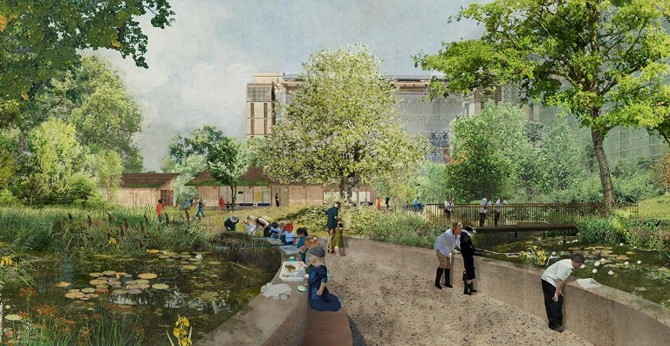
A Living Laboratory
Our gardens are a hub for urban nature identification and field survey skills

Slide 14
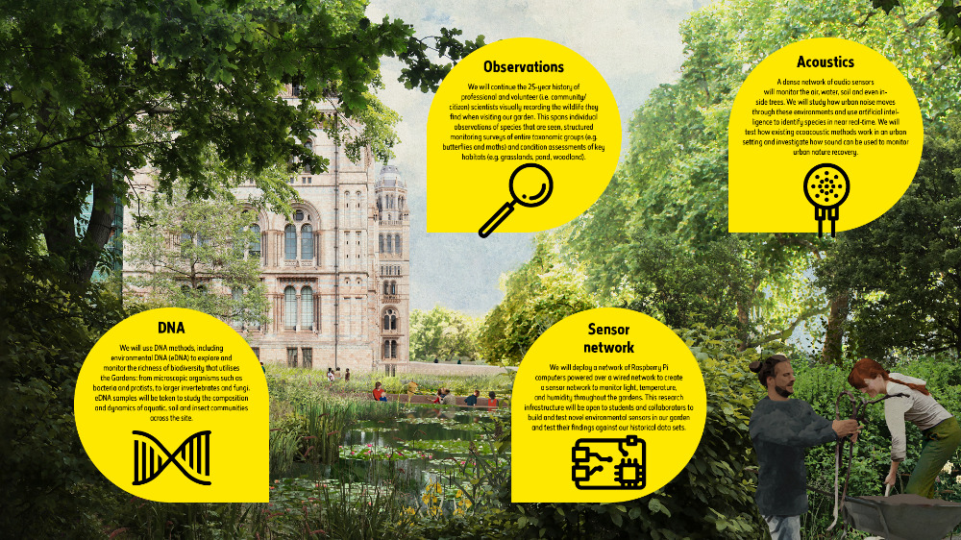

Slide 15
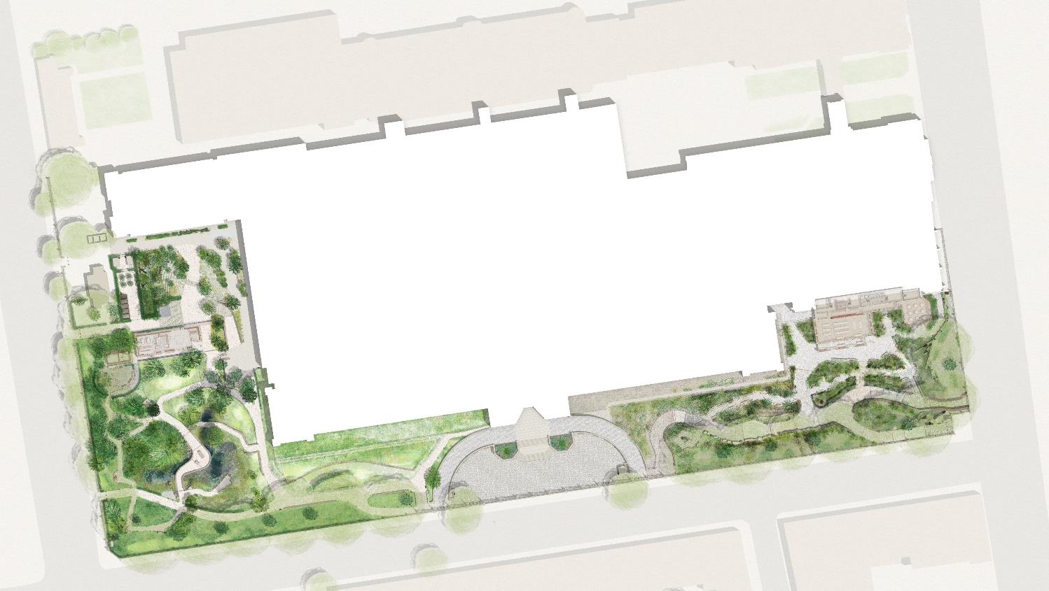
A Living Laboratory
Power-over-Ethernet locations
Long-term (intense, untargeted) monitoring plus detailed case studies of how habitat translocation, creation and restoration actions impact biodiversity
Over-specified (plenty of excess compute, transfer) – capacity to double number of devices. Testing arena for more targeted, less power hungry devices.
Background data:
One of the most intensively studied urban sites for 25 years

Slide 16
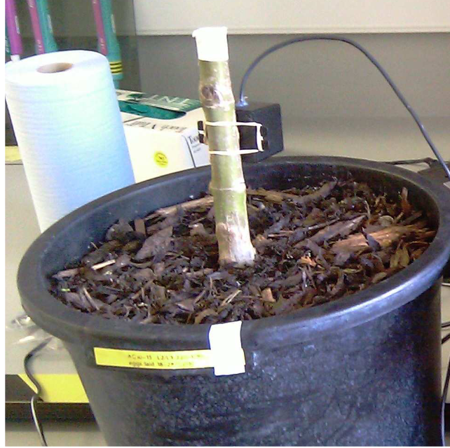

Slide 17
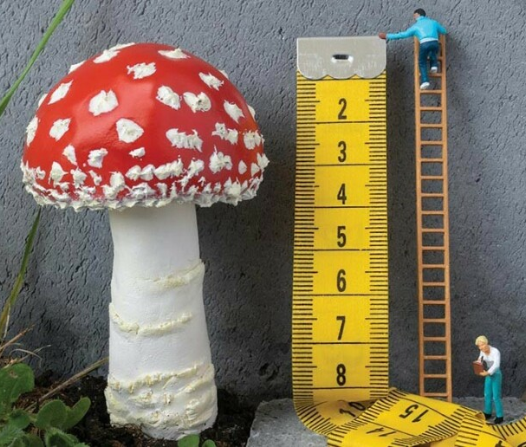
Continuous audio data High environmental sensor density Regular traditional surveys eDNA (water, soil, malaise)

Slide 18
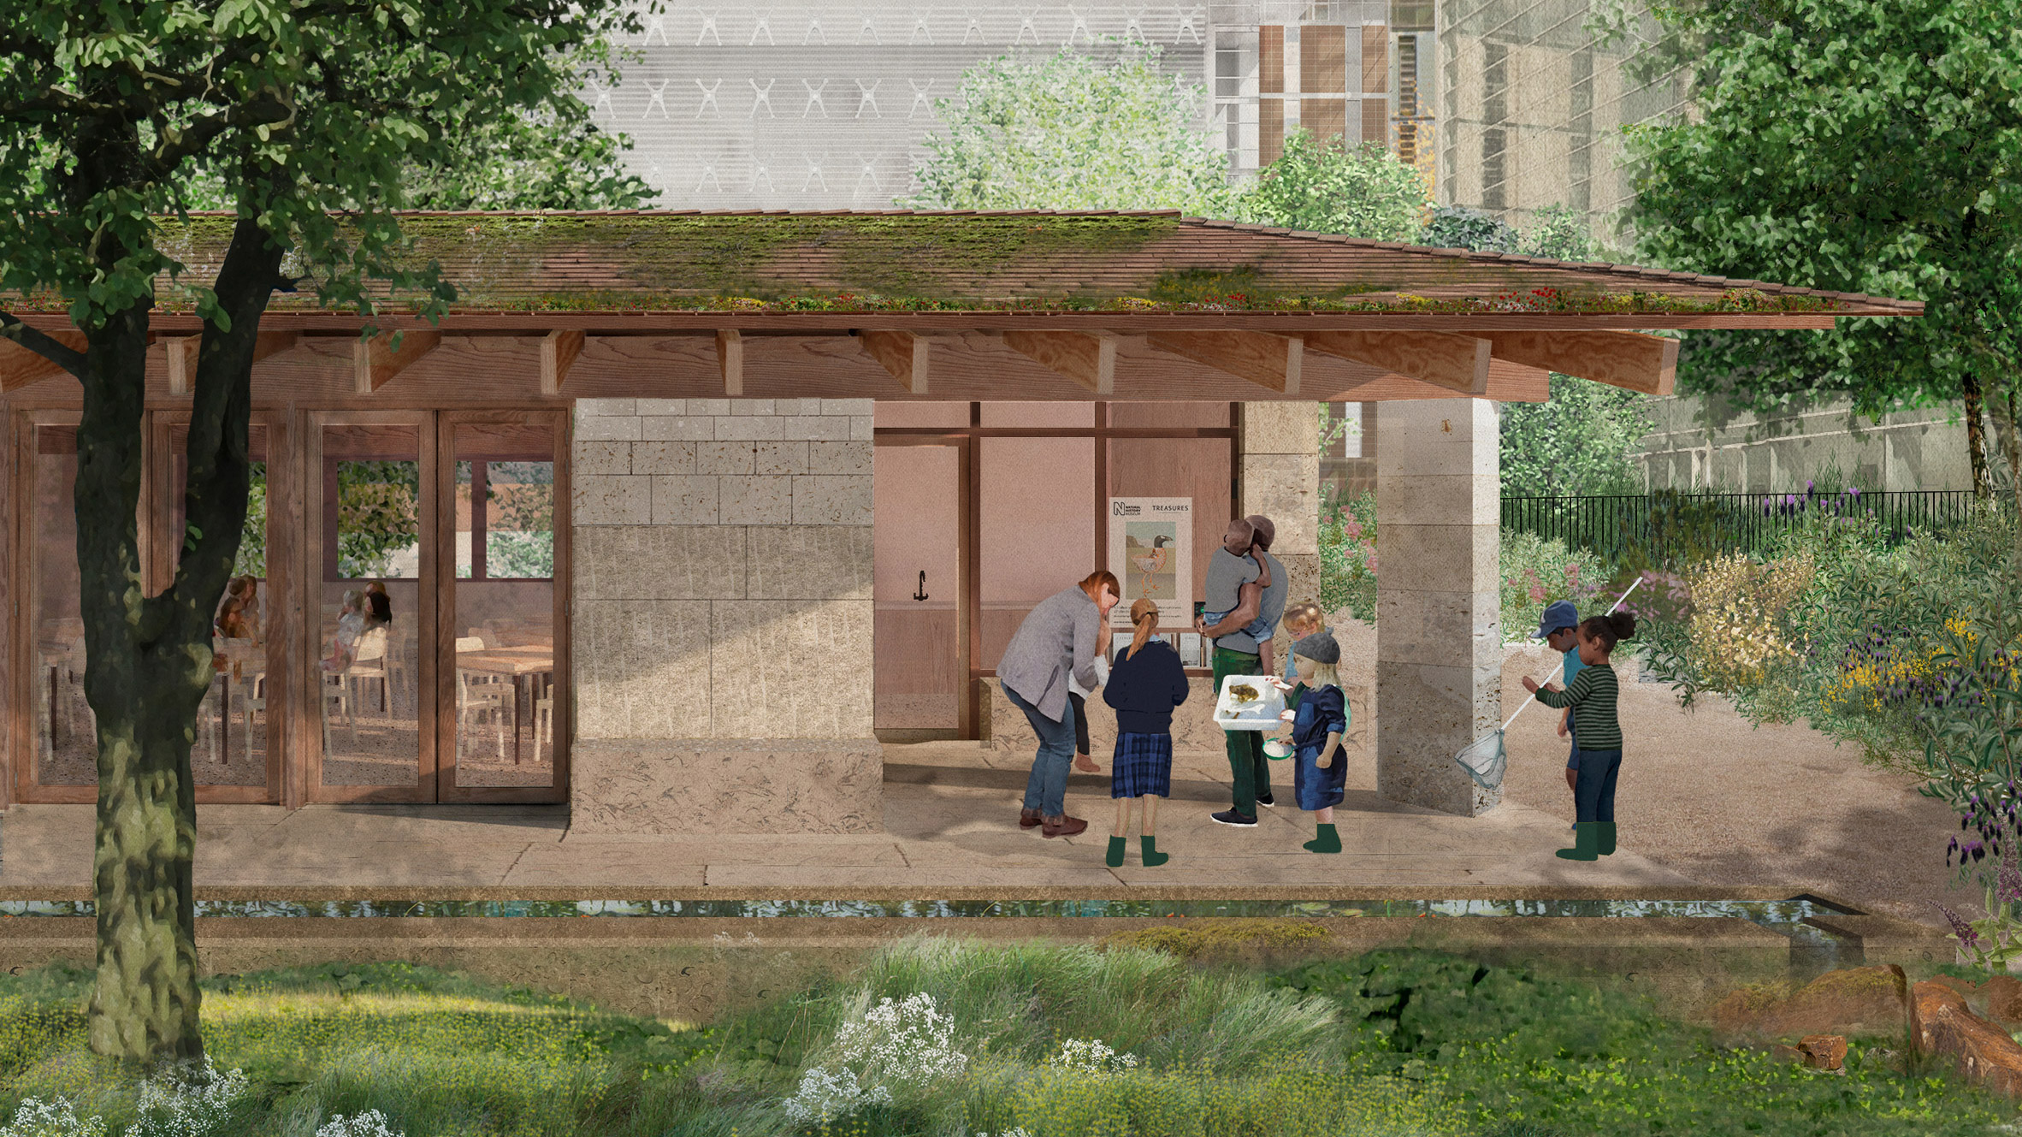
Education and engagement
Nature Activity Centre supported by AWS
Listening funnels (curated soundscapes from grounds) with interpretation panels
Digital panel with real-time identifications and interpretation

Slide 19
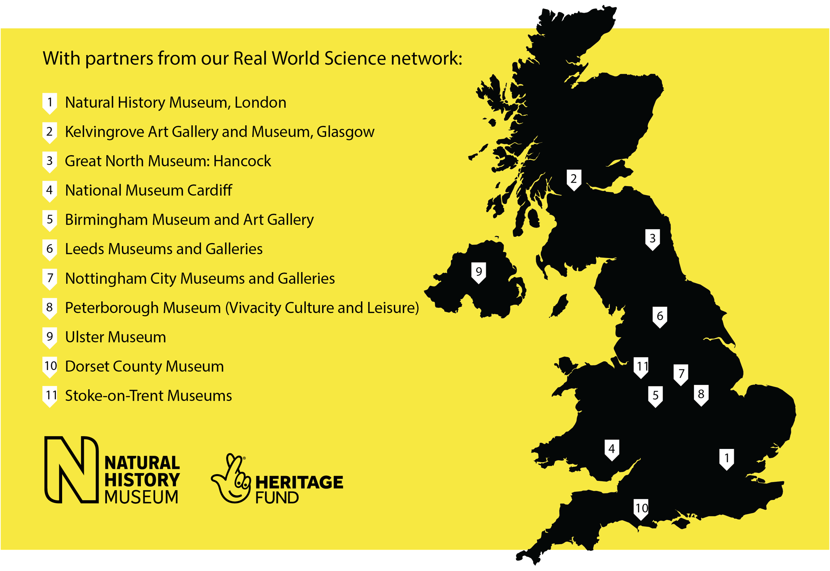
Urban Nature Project
Partner Network

Slide 20
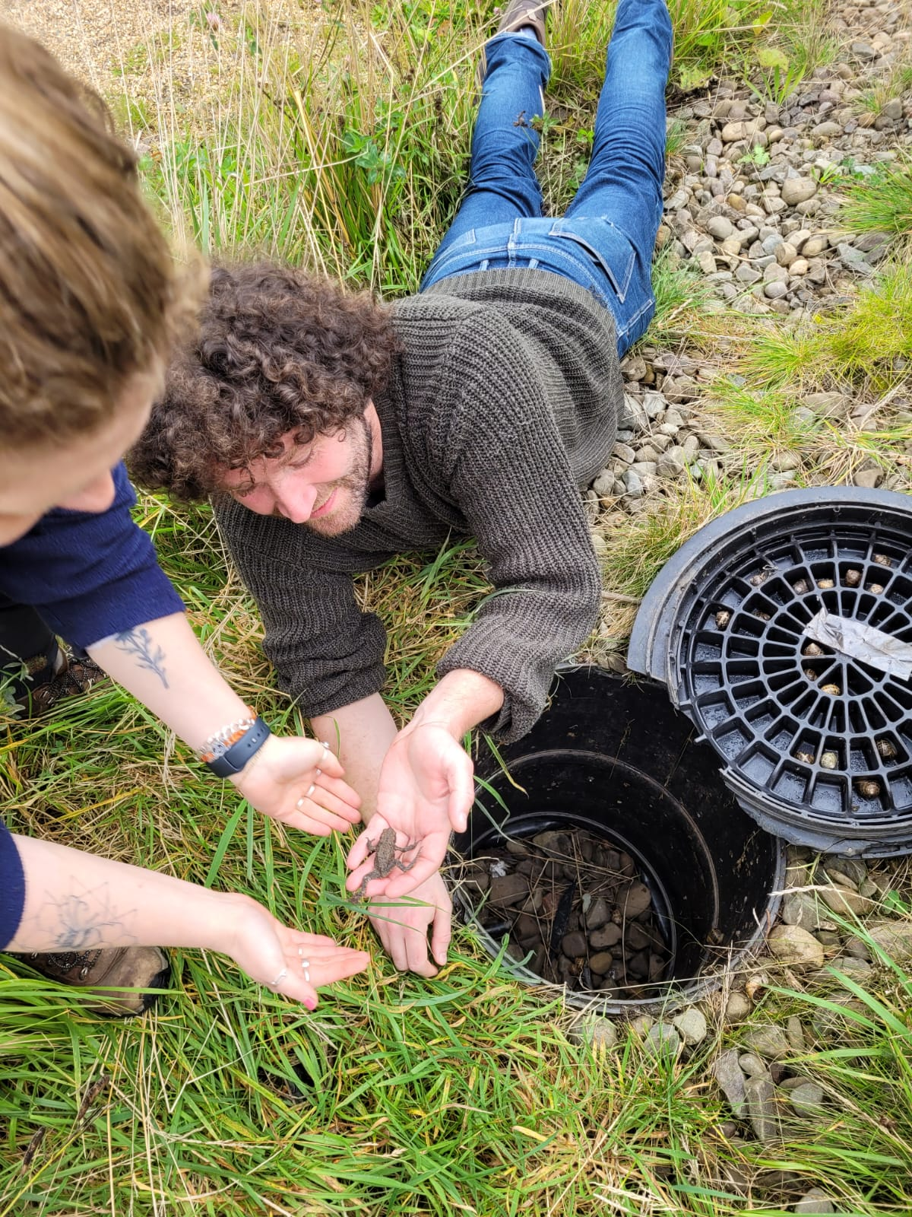
Acoustics with Partner Sites
Audiomoth surveys
Soil/water/malaise eDNA
Research focus:
Latitudinal changes across UK
Correlation of ecoacoustic metrics with eDNA (over seasons and latitude)
CONFIDENTIAL
© The Trustees of the Natural History Museum, London

Slide 21
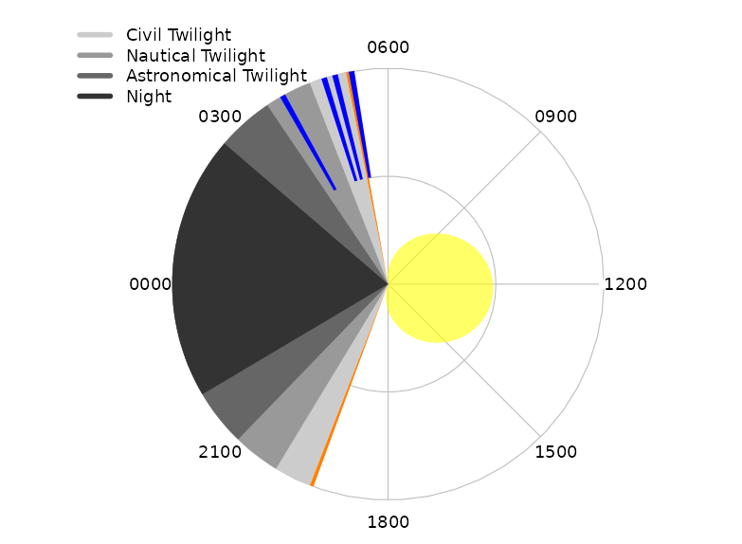

Slide 22
Sampled data Single audiomoth eDNA

Slide 23
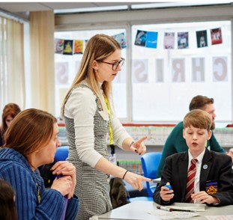
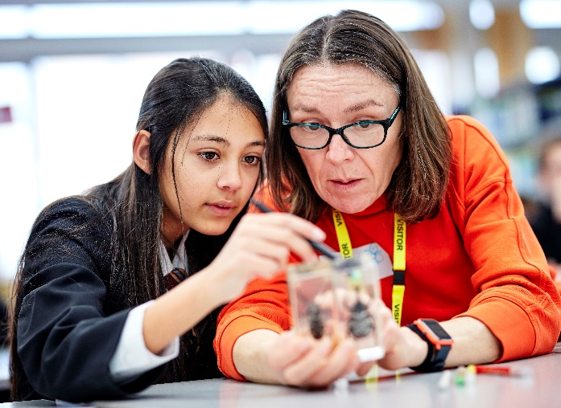
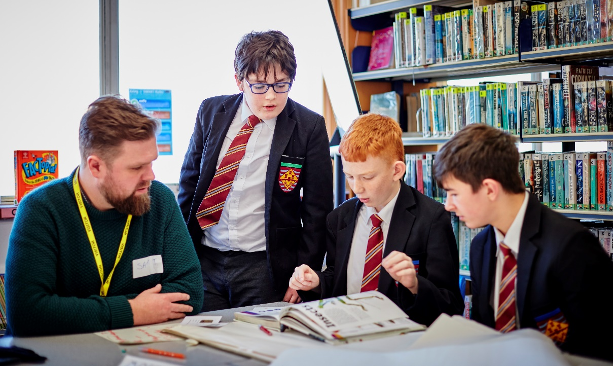
Nature Overheard
Co-design workshops with students and Museum scientists to produce a scientific question​
Nature Overheard investigates how road noise affects wildlife
Recordings from mobile devices and short online survey
nhm.ac.uk/natureoverheard

Slide 24
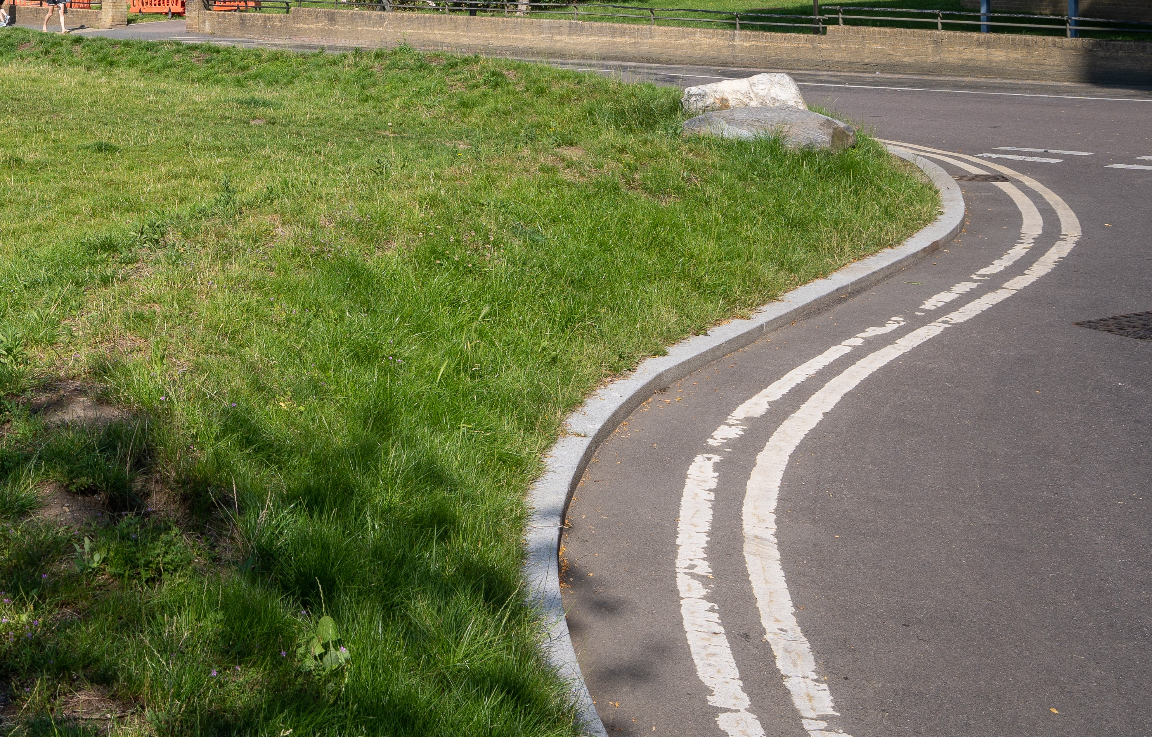
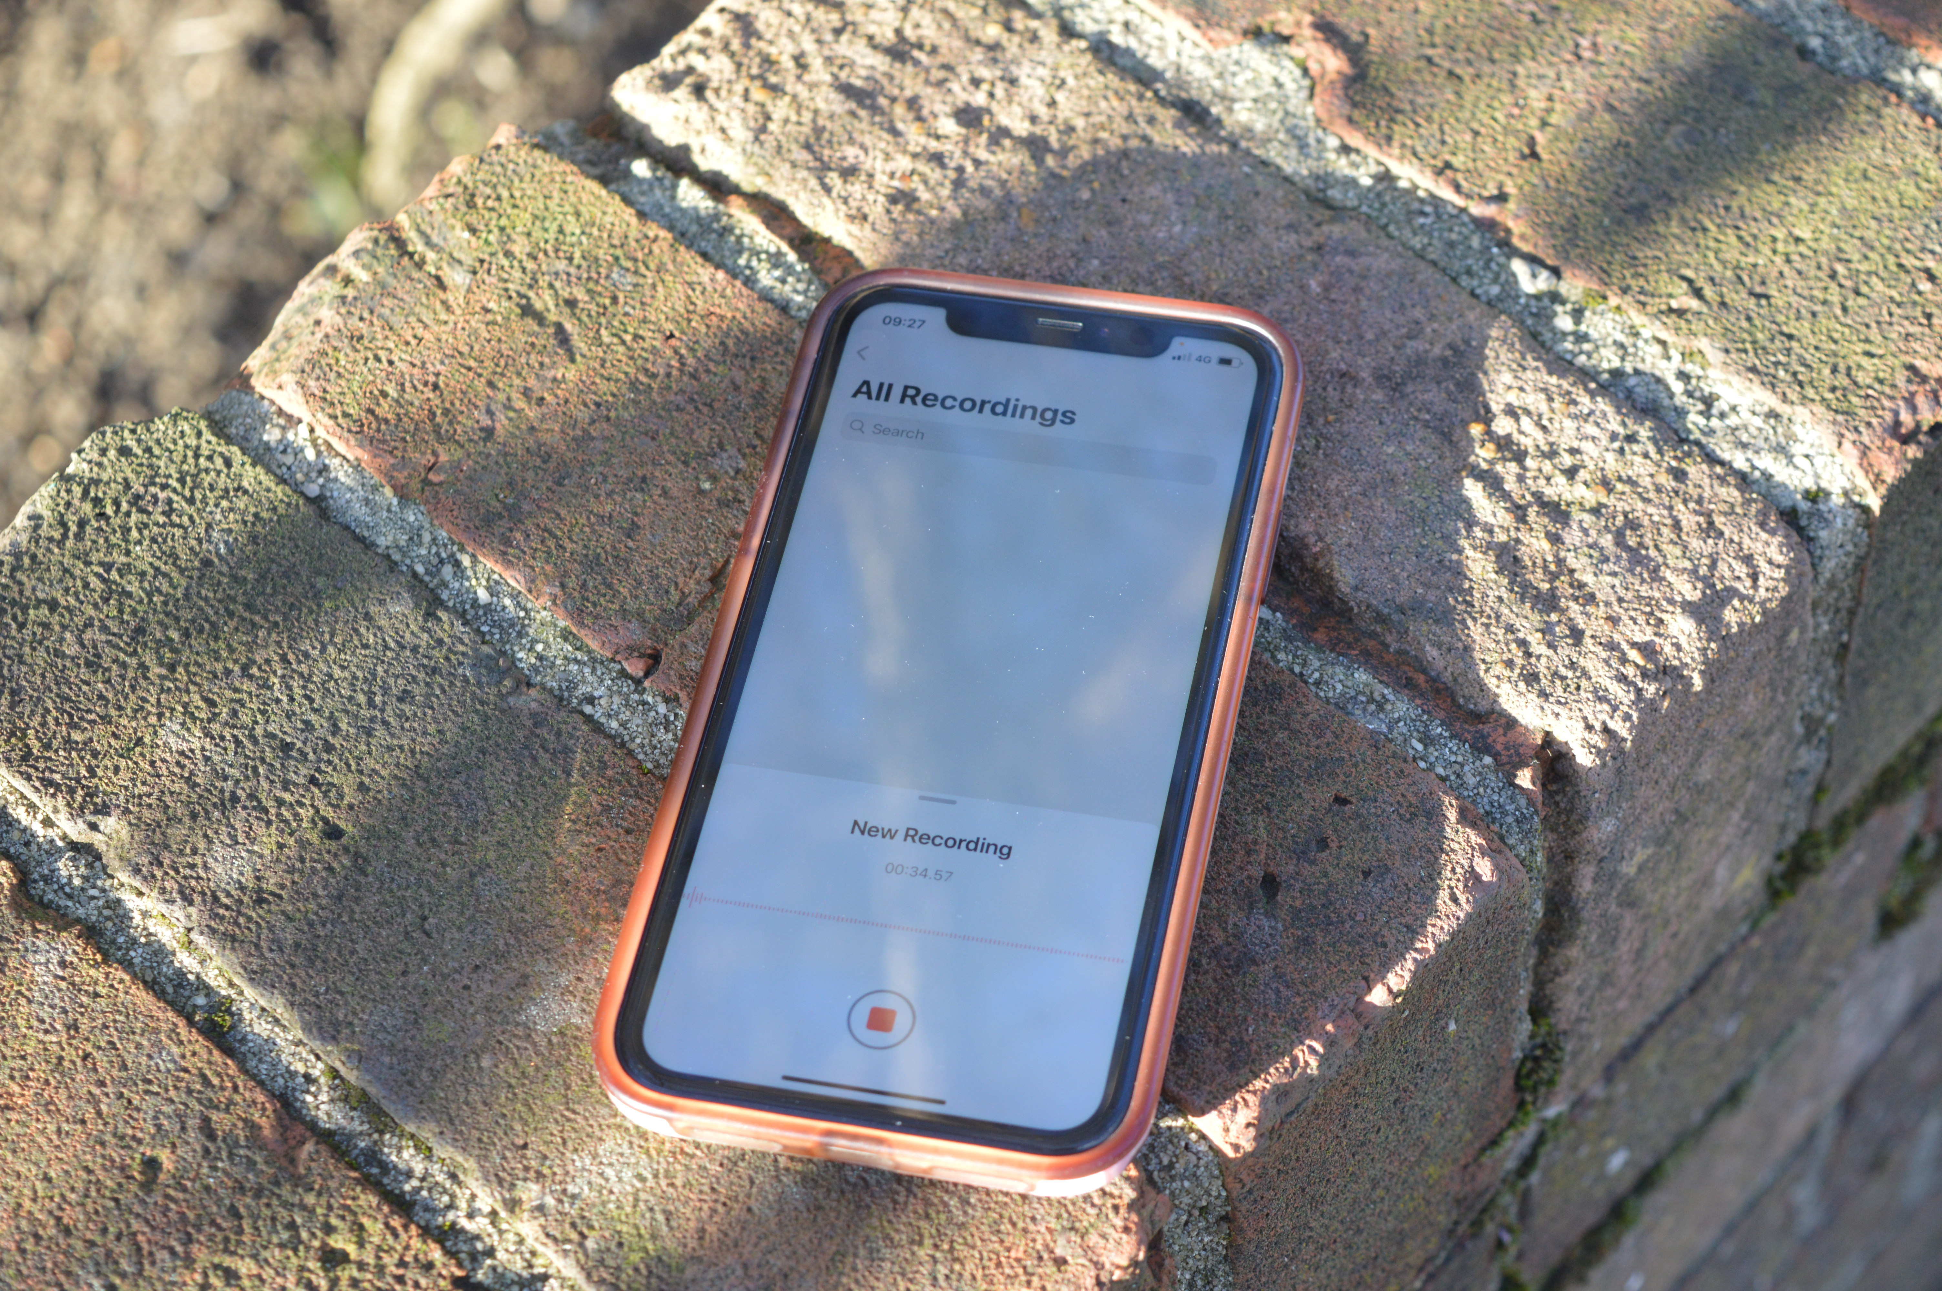
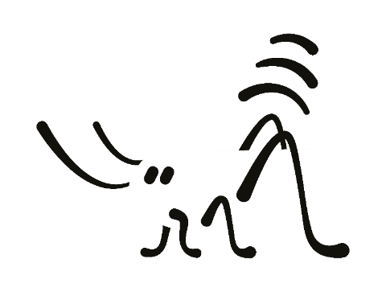

Nature Overheard
Co-created citizen science
nhm.ac.uk/natureoverheard

Slide 25
A bit on NOISE
It is estimated that the annual social cost of urban road noise in England is £7 billion to £10 billion.
Most studies focus on mammals
What about non-airborne sounds?
Can we find mitigations that also support biodiversity recovery?
https://www.gov.uk/guidance/noise-pollution-economic-analysis

Slide 26
Random data points Phones / tablets / mysterious

Slide 27
Integration

Slide 28
The Museum’s approach
BIOACOUSTICS
ECOACOUSTICS
Single species
Ecosystems
Species descriptions
Behavioural studies
Statistical analyses
Machine Learning
Curated reference sound collections
Soundscape collections
Single microphone devices
Connected sensor networks

Slide 29
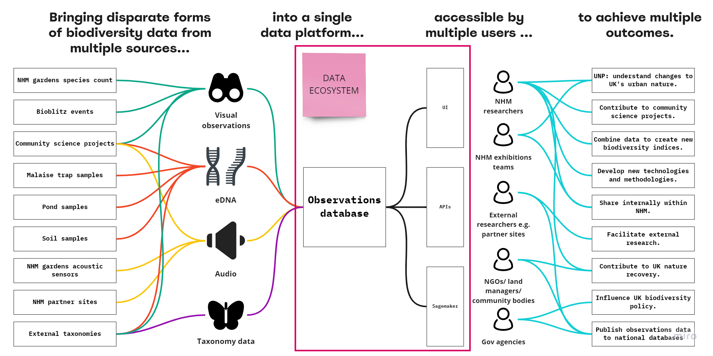
Data Ecosystem
AWS – new NHM Team
nhm.ac.uk/natureoverheard

Slide 30
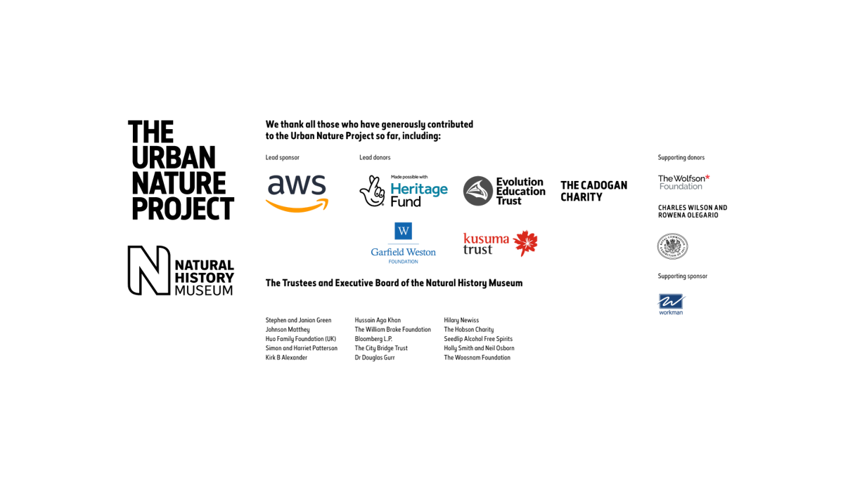
Thank you!
edward.baker@nhm.ac.uk
@edwbaker

